Slide 1

SAE Formula Electric
ECE Team #3/ME Team #21
Milestone: 4
Test Plan
TEAM MEMBERS:
Aldreya Acosta
Tomas Bacci
Danny Covyeau
Scott Hill
Stephen Kempinski
Ryan Luback
George Nimick
SAM Risberg
Corey Souders

Slide 2
Top Level Electrical System
Presented by:
DANNY cOVYEAU

Slide 4
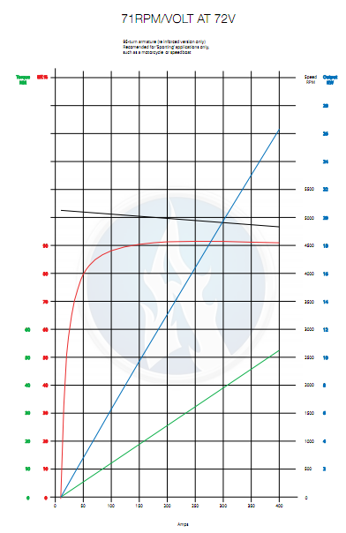
Agni 95-R Motor
Peak Efficiency: 93%
Constant Torque: 42 Nm
Continuous Output Power: 22 kW
Weight: 24 lbs
Popular, dependable choice among Formula Hybrid teams

Slide 5
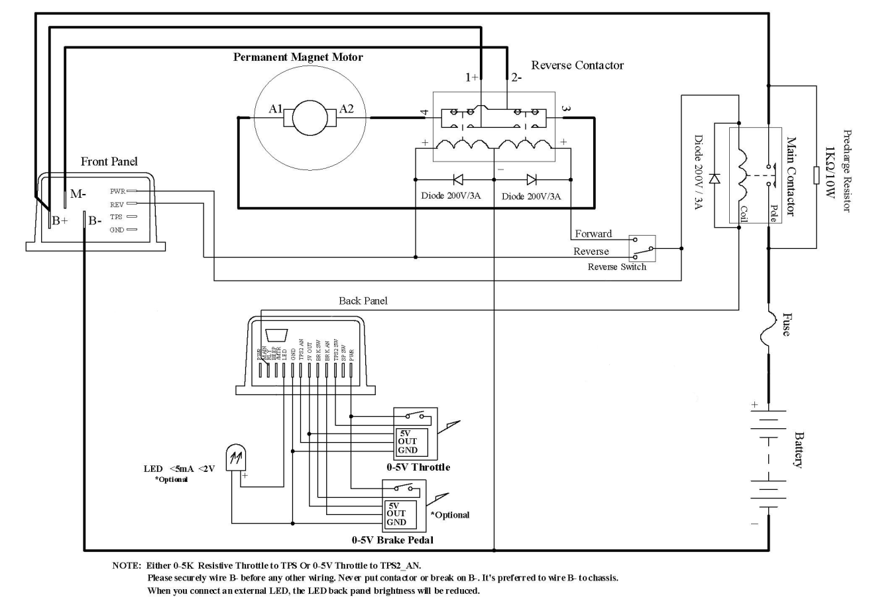
Kelly KD72501 Motor Controller
Optical Isolated:
  throttle potentiometer
  brake potentiometer
  switches
Uses high power MOSFETs to achieve ~99% efficiency
200 Amps continuous
500 Amp peak for 1 minute
Built in regenerative braking that can recapture up to 100 amps
  Still requires mechanical brakes
Programmable controller with a user-friendly GUI
* Courtesy Kelly KD User Manual

Slide 6
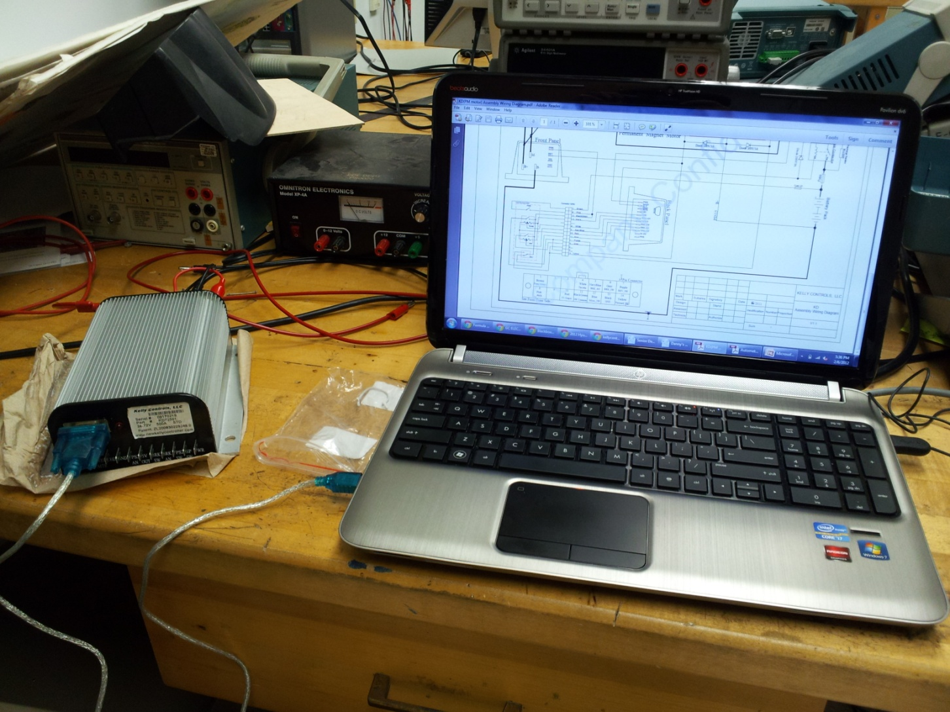
Motor & Controller Testing
Objective:
Verify that the electric motor controller works properly by testing that the forward and reverse functions of the motor operate
Desired Result:
The controller will be able to accelerate in both the forward and reverse directions
Status:
Controller has not been able to be programmed due to frequent resetting and under voltage warnings
Next Step:
Use a more powerful power supply (~80 VDC) to eliminate under voltage warnings and attempt to eliminate frequent resetting. Once the controller can be programmed the motor will be wired up.

Slide 7
Controller Contingency Plan(s)
Kelly KDH07501A - $599
  Optically isolated
  24 – 72 VDC, 500A with Regen
Kelly KDH12601E - $999
  Optically isolated
  12 – 120 VDC, 600A with Regen
Both controllers eliminate the need for the isolation circuit

Slide 8
Optoisolator Circuit Testing
Objectives:
  The LV and HV grounds have a minimum resistance of 40,000 ohms between them
  The output voltage of the circuit corresponds linearly with the input voltage of the circuit
Test Plan:
  Use a low voltage variable DC power supply and a voltmeter to test the optoisolator circuit will be built.
Desired Result:
  The input and output voltage of the throttle should vary from zero to five volts linearly.

Slide 9
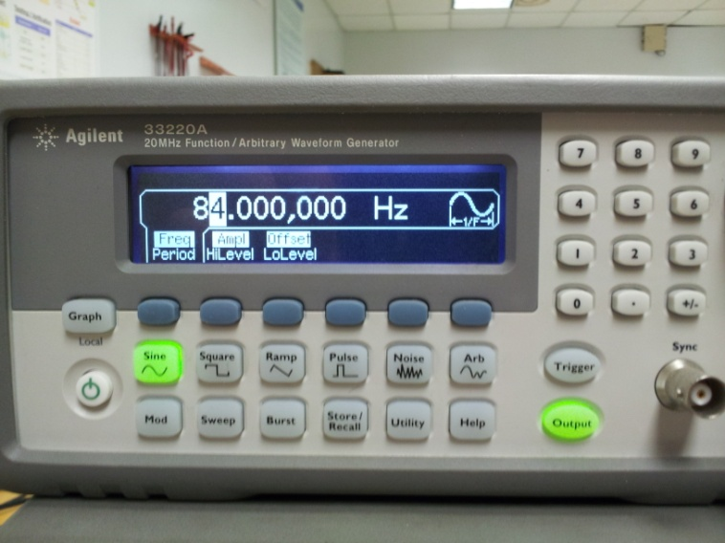

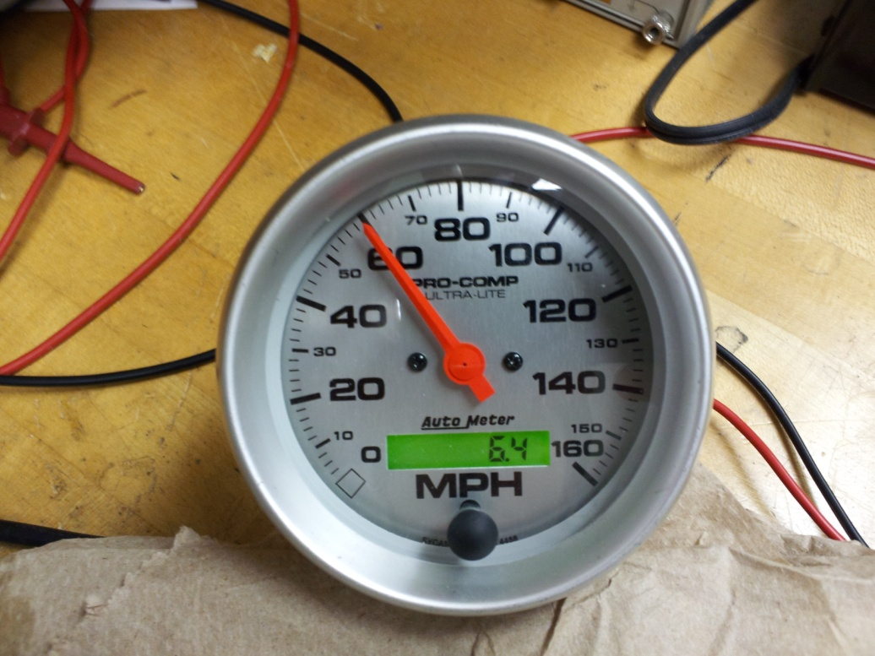
Speedometer Testing
Calibrated Using Sine Wave Generator
Requires at least 500 pulses per mile from a Hall Effect Sensor
Status:
  Tested Successfully

Slide 10
Potbox Testing
Objective:
  To verify the proper operation of the throttle potentiometer (potbox).
Test Plan:
  Attach potbox to 5 VDC power supply and verify that the output ranges between 0 and 5 volts using a voltmeter
Desired Result:
  The potbox is expected to act as a simple voltage divider and deliver voltage levels that range from zero to five volts.
  The potbox must deliver a range of voltages between zero and five volts to be considered functional.

Slide 11
Battery System, BMS, Other electrical components
Presented by:
Scott Hill

Slide 12

Major Design Changes in Battery System
The following issues occurred in the ordering process of the batteries:
  Company (hobbyking.com) did not accept purchase orders and it was hard to communicate with them
  The team tried to order the batteries through a local hobby store and the markup was higher than the seller told us it would be so it was rejected.
  Two members of the team attempted to order the batteries themselves and be reimbursed. By the time the orders had been placed the batteries were on backorder and would be for about a month

Slide 13

Major Design Changes in Battery System (Cont.)
When the team found out that the batteries had been placed on backorder it was around late January and the timeframe of waiting on the backorder and shipping was not acceptable.
Alternatives were looked at through local retailers Battery Source and Fouraker Electronics.
Both companies could order through powersonic.com

Slide 14
Battery Types Available
Lead Acid ( Various types)
  Pros: Low Price, Simple BMS needs, higher voltages easily obtained, longer lifetime than Li-Po
  Cons: More weight, lower discharge than desired
Nickel-Metal Hydride
  Pros: Less weight, lower price than Li-Po batteries
  Cons: Lower voltage (more batteries required), lower discharge than desired

Slide 15
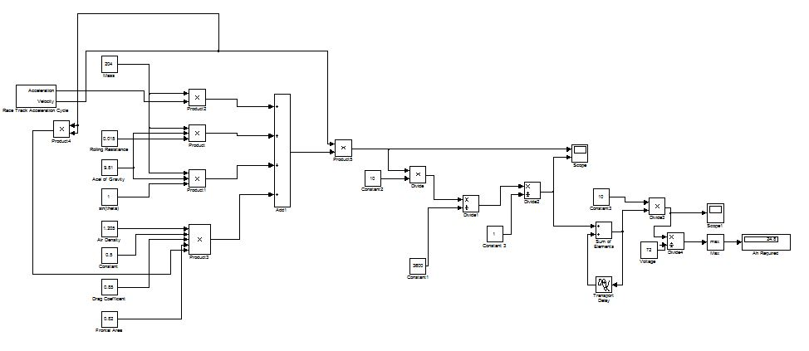
New Battery Configuration
After looking at powersonic’s website a high rate series lead acid battery was found.
Taking the higher weight into consideration and running the MATLAB simulation with the new estimated weight the team decided to go with a 36Ah battery.

Slide 16

Battery Specs
Battery Characteristics
Voltage | 12V
Capacity | 36Ah
Weight | 26.6lbs
Max Discharge Current (5s) | 300A
Max Short-Duration Discharge Current | 660A
Internal Resistance | 13mΩ
Max Charging Current | 9.9A
PHR-12150 High Rate Series
Characteristics | Lead Acid (High Rate Series) | Nickel Cadmium | Lithium Polymer
Weight | 159.6lbs | 84.66lbs | 30.6lbs
Max Discharge Current | 300A | 320A | 600A
Number of Batteries | 6 | 240 | 120
Cost per Battery | $124.95 | Unknown | $8.95

Slide 17

BMS Changes
BMS Requirements
  Li-Po Design
    Temperature monitoring per module
    Voltage monitoring per cell
  Lead Acid Design
    Temperature monitoring per module
Benefits of Lead Acid Configuration
  Since there are only 6 batteries less monitoring is needed
  Voltage monitoring is not required like with the Li-Po batteries

Slide 18
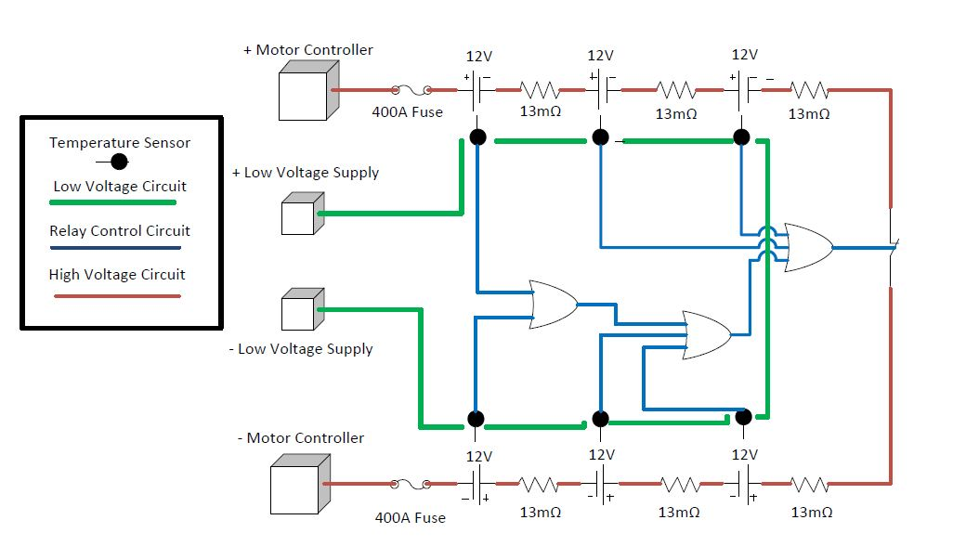
New Battery System and BMS schematic

Slide 19
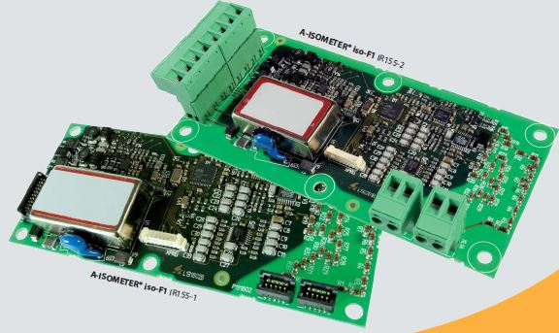
Ground Fault Detection

Slide 20
Ground Fault Detection Circuit
Add GFD circuit here

Slide 21
Battery System and BMS Test Plan
Things to be tested
      Individual battery characteristics such as discharge characteristics, capacity and voltage will be tested.
      BMS circuit will be tested to make sure that if the temperature of the lead acid batteries gets too high then the system will automatically shut off.
      Ground fault detection circuit needs to be tested to make sure if a short occurs between the HV and LV circuits the system will be shut off.

Slide 22
Top Level Mechanical System
Presented by:
George Nimick

Slide 23
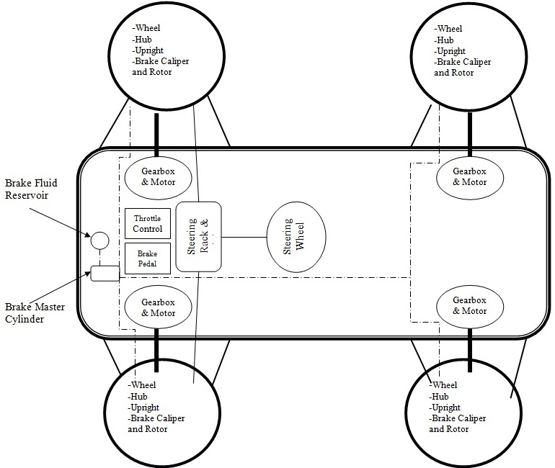

Slide 24
Chassis
Presented by:
George Nimick

Slide 25
Chassis Design – Approach
Purpose
  Structural Barrier
    Debris and accidents
    Enclosure
    Incorporation of a body
  Platform for mounting systems
    Steering, Braking, Suspension, Propulsion, Driver Equipment

Slide 26
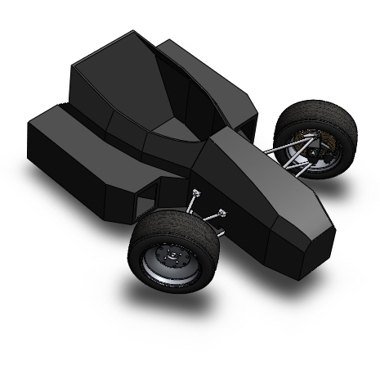
Chassis – Material Selection
Major types:
  Monocoque
  Tubular
    Metal
      Steel
      1018 vs. 4130
Restrictions based on rules
  Angles
  Distances
  Wall thicknesses

Slide 27


Chassis - Calculations
Bending Stiffness
  Proportional to E*I
  Primarily based on I
Bending Strength
  Given by
Compare to requirements in rules

Slide 28
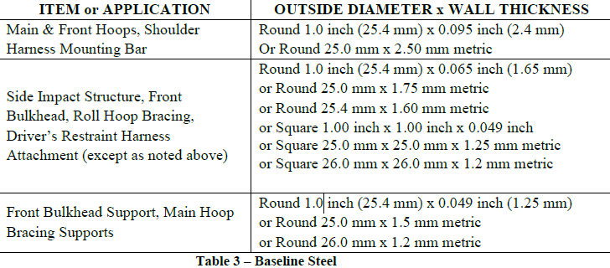
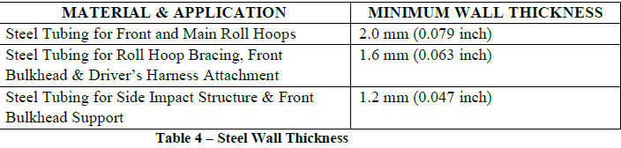
Chassis – Tubing Specifications

Slide 29
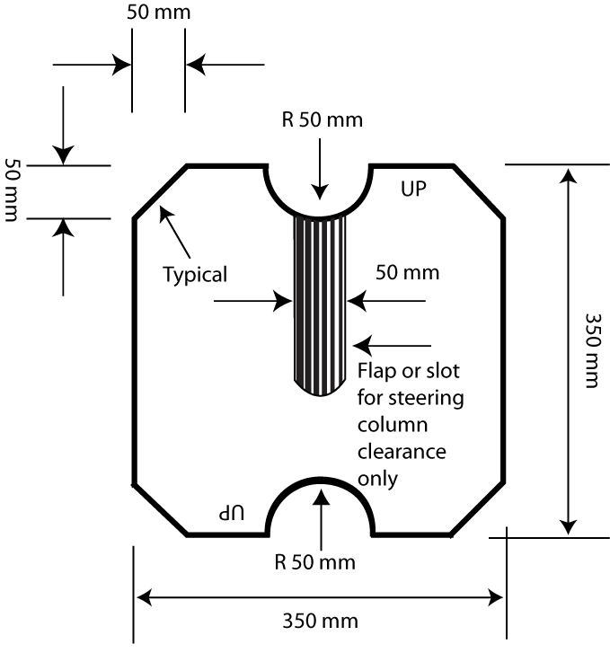
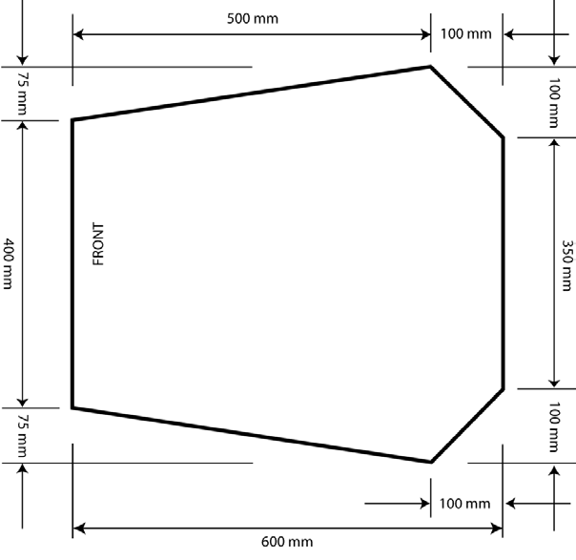
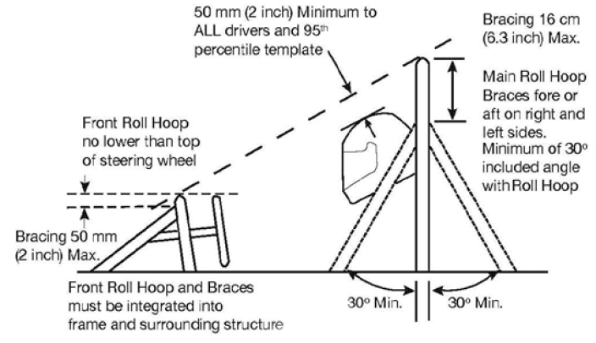
Chassis - Restrictions
Template for
Cock-pit Opening
Template for
Cross-Sectional Area
Roll Hoop Restrictions

Slide 30
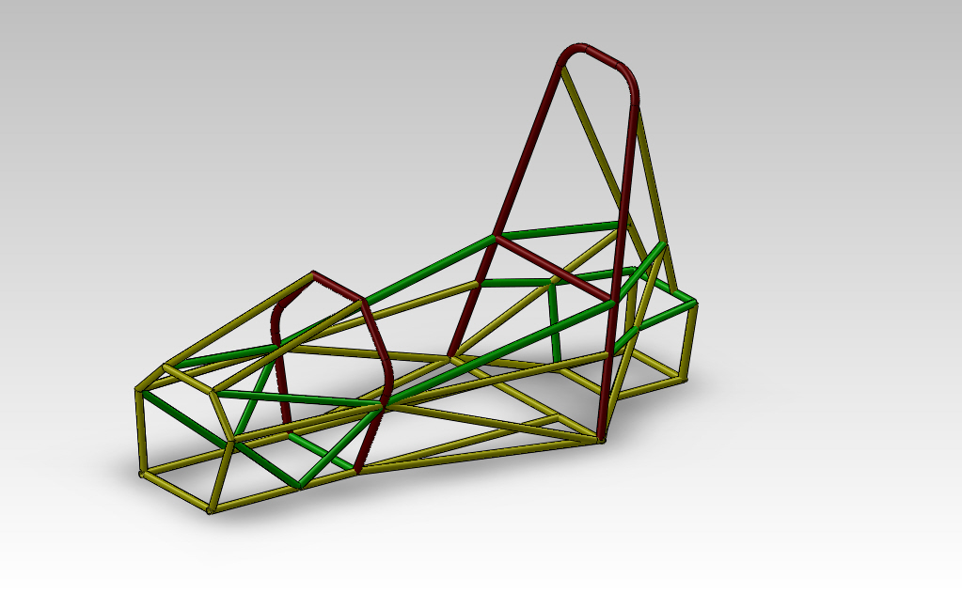
Chassis

Slide 31
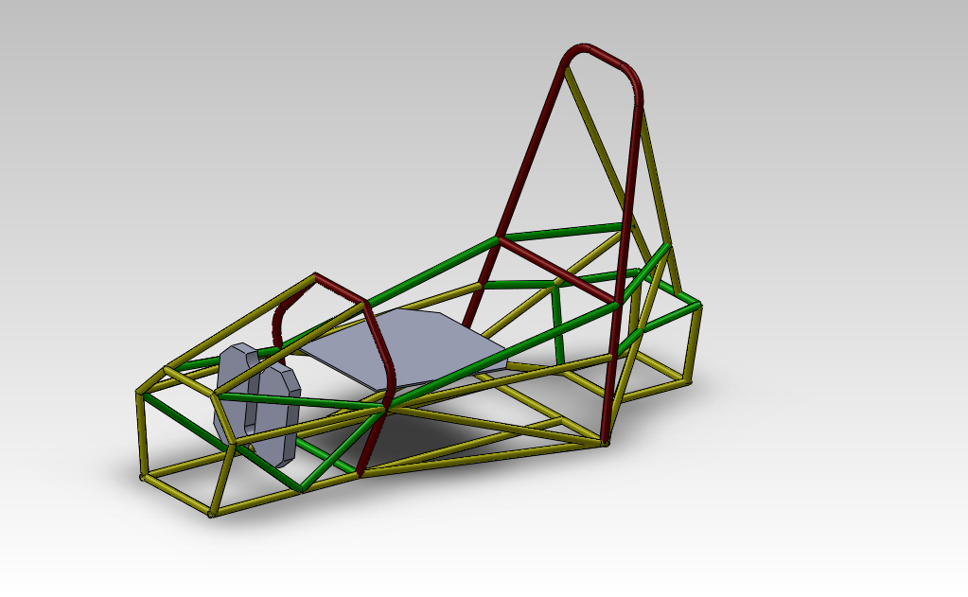
Chassis – Test Plan 1

Slide 32
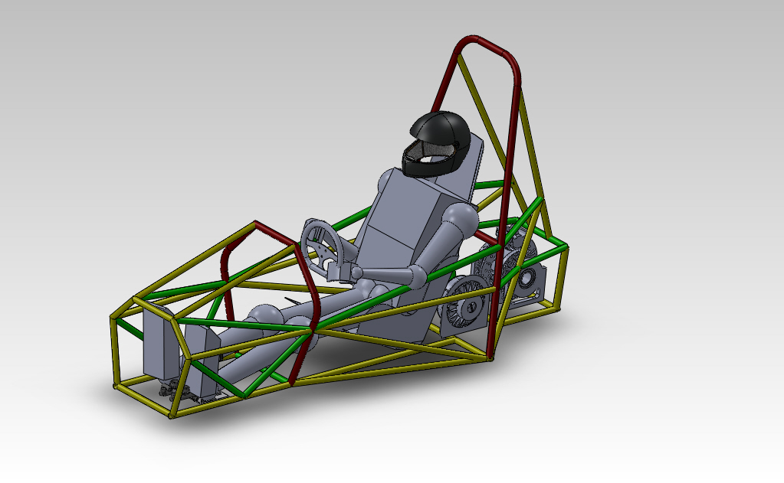
Chassis – Test Plan 2

Slide 33
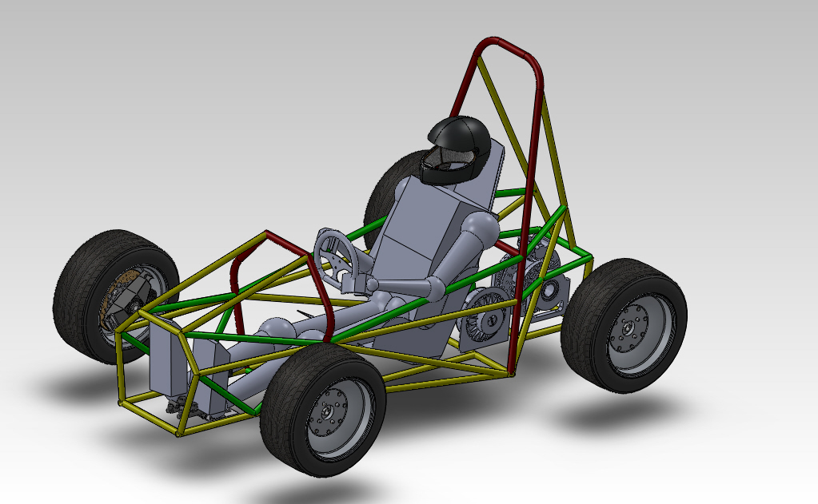
Chassis

Slide 34
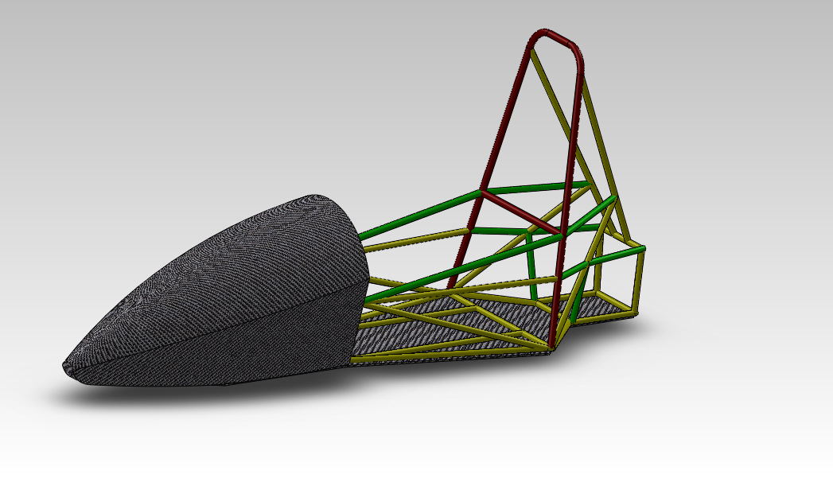
Chassis

Slide 35
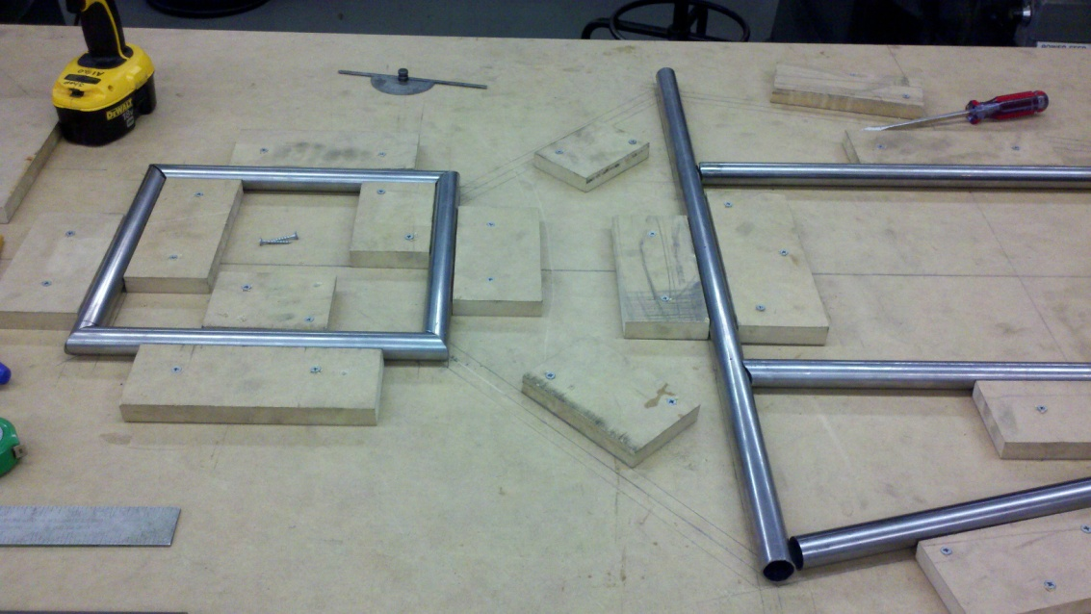
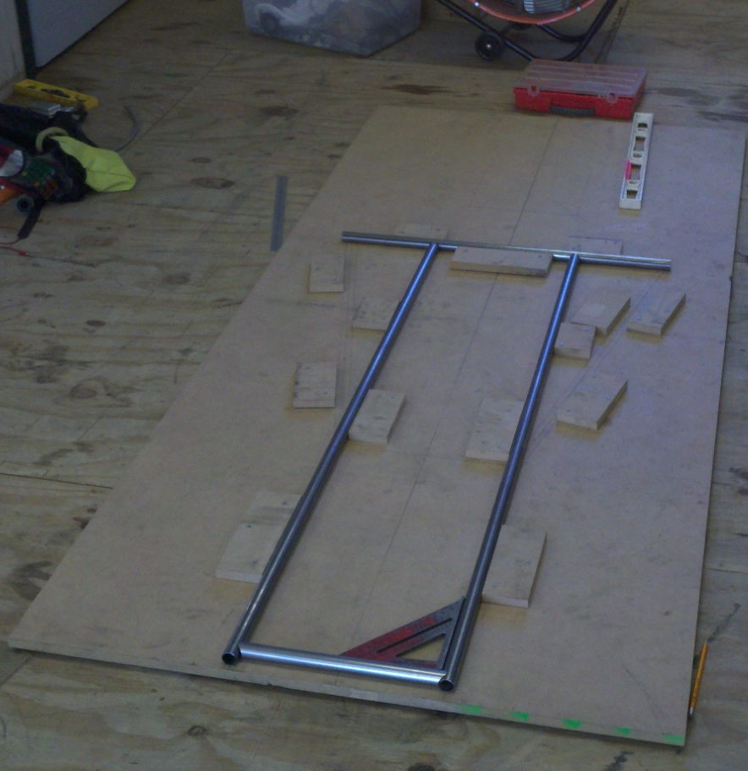
Chassis
Jig fabrication
Placement sketched
Blocks screwed into position
Members cut and placed

Slide 36
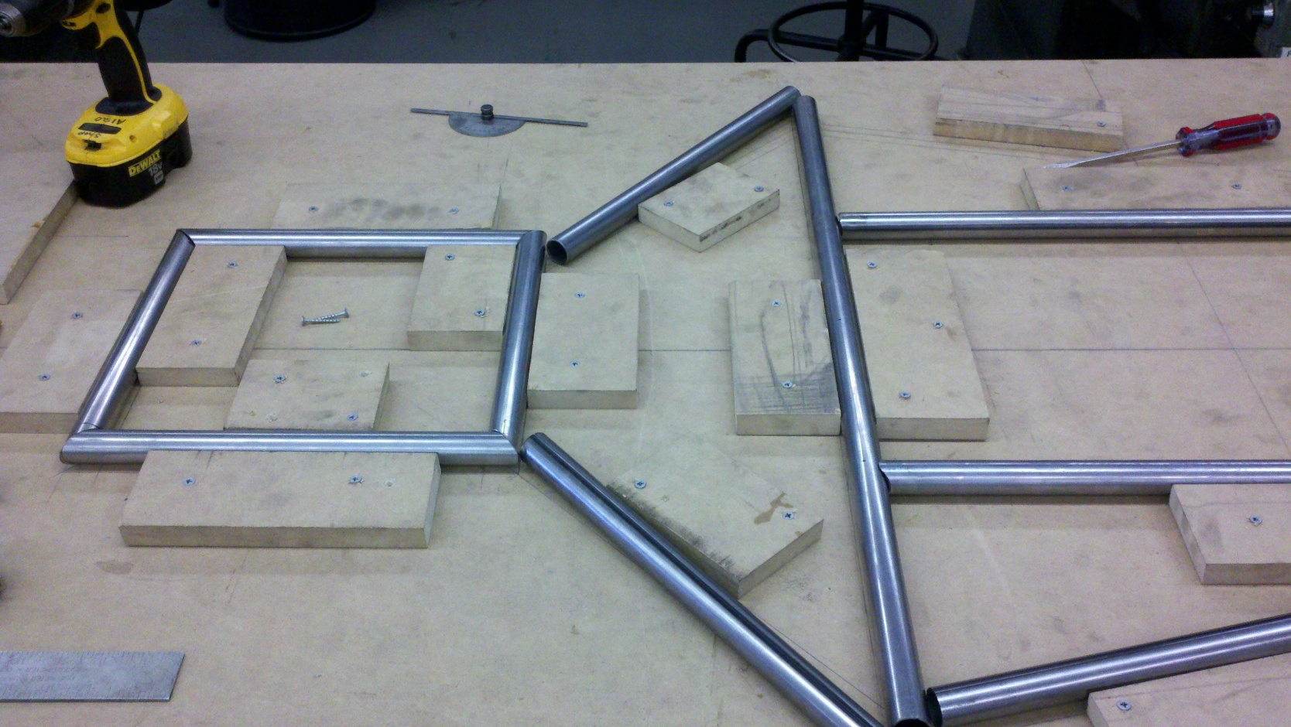
Chassis

Slide 37
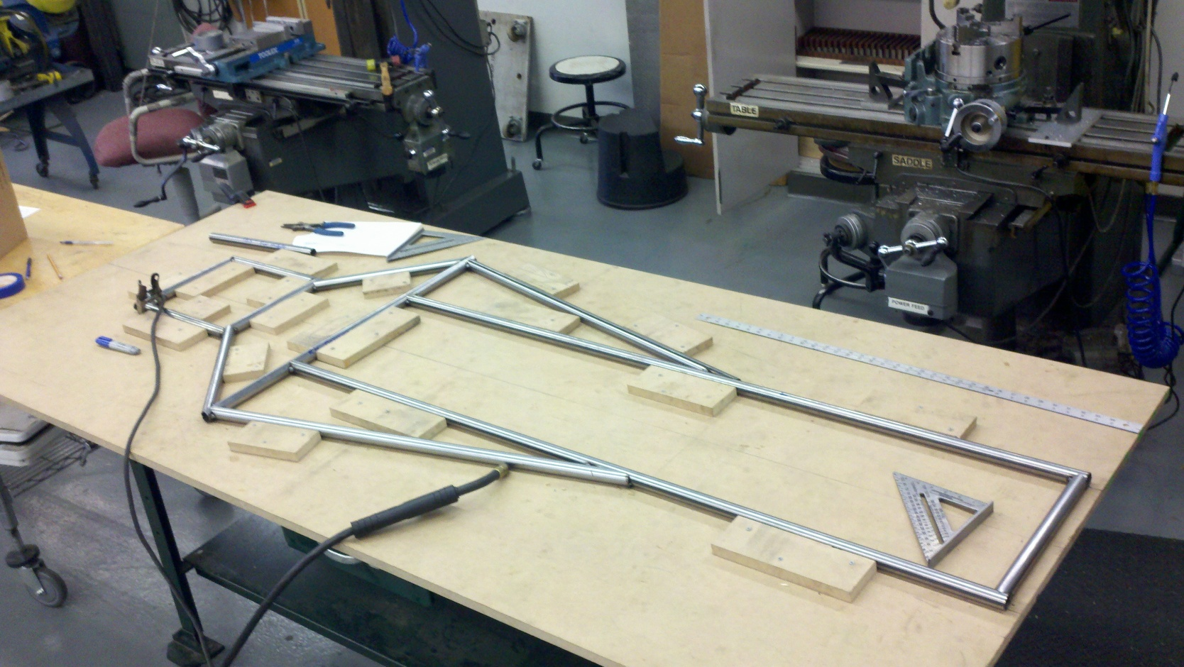
Chassis

Slide 38
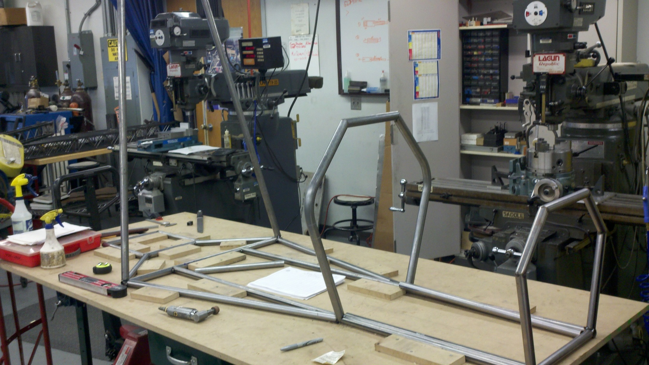
Chassis

Slide 39
FEA Tests Performed
Finite Element Analysis
Difficult to perform and properly assess
Tests performed
  Front Impact
  Rear Impact
  Side Impact
  Full Suspension Loading
  Single Side Loading for suspension

Slide 40
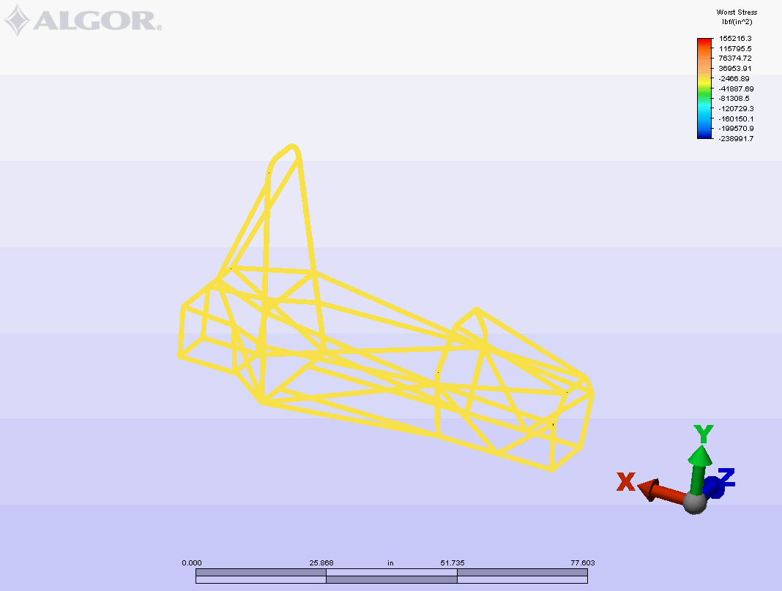
Front Impact - Worst Stress

Slide 41
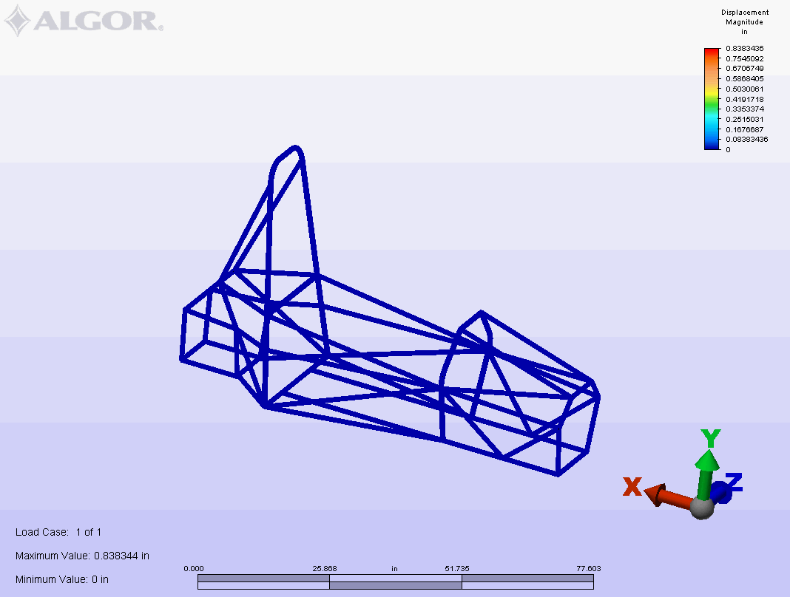
Front Impact - Displacement

Slide 42
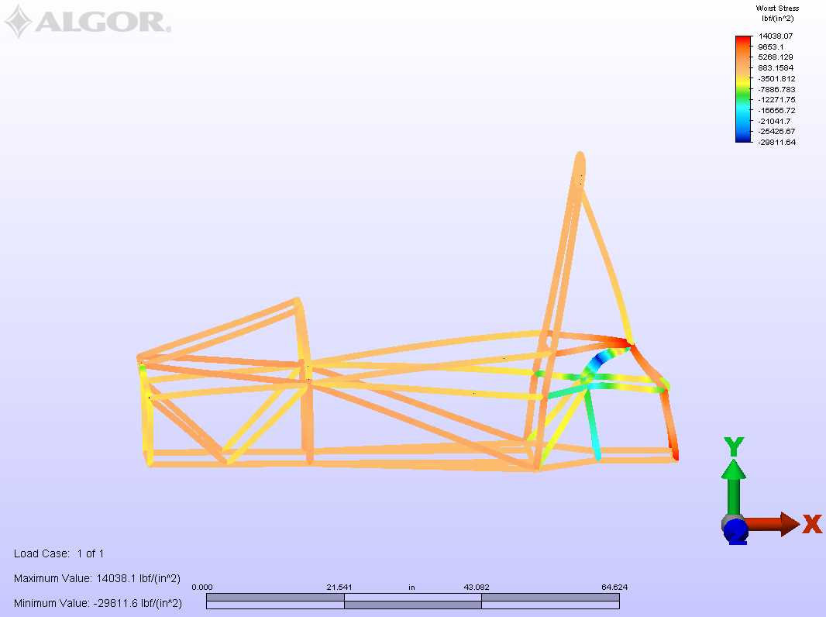
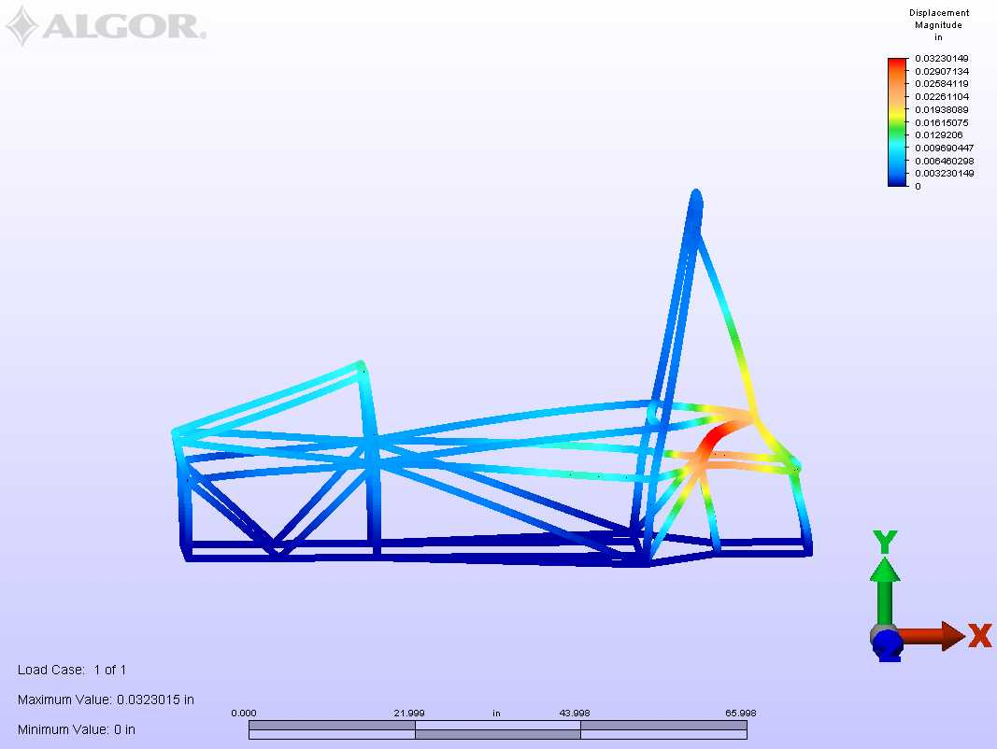
Full Suspension Test
Displays Displacement
Magnitude
Displays Worst Stresses

Slide 43
Suspension
Presented by:
Stephen Kempinski

Slide 44
What’s to come
Brief overview
Current progress
Deadline
Test plan

Slide 45
Competition Constraints
3.2.1 Suspension
fully operational suspension system with shock absorbers, front and rear
usable wheel travel of at least 50.8 mm (2 inches), 25.4 mm (1 inch) jounce and 25.4 mm (1 inch) rebound, with driver seated.
3.2.2 Ground Clearance
with the driver aboard there must be a minimum of 25.4 mm (1 inch) of static ground clearance under the complete car at all times.

Slide 46
Competition Constraints Continued
3.2.3 Wheels and Tires
3.2.3.1 Wheels
The wheels of the car must be 203.2 mm (8.0 inches) or more in diameter.
3.2.3.2 Tires
Vehicles may have two types of tires as follows:
Dry Tires – The tires on the vehicle when it is presented for technical inspection are defined as its “Dry Tires”. The dry tires may be any size or type. They may be slicks or treaded.
Rain Tires – Rain tires may be any size or type of treaded or grooved tire provided:

Slide 47
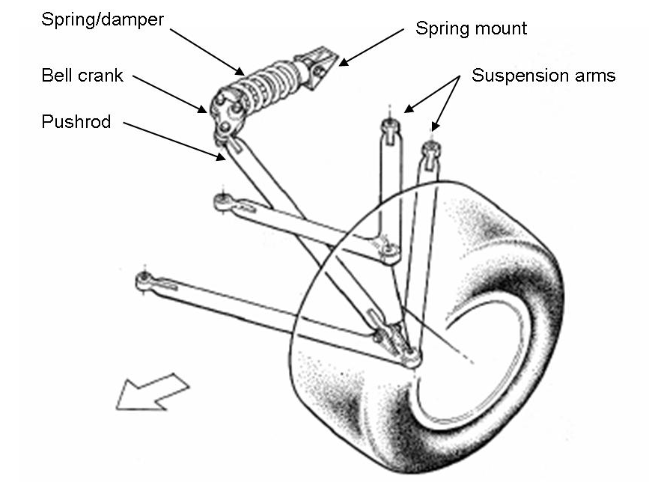
Suspension Design Overview
Independent
Short-Long Arm
Push-rod
Better ride quality
Improved handling
fully adjustable
Short Long Arm Suspension
Lower A-Arm is longer than the Upper A-Arm
Reduced changes in camber angles
Reduces tire wear
Increases contact patch for improved traction

Slide 48
Design Method
Determine Wheel-Base, Track-Width
Design for FVSA
Design for SVSA

Slide 49
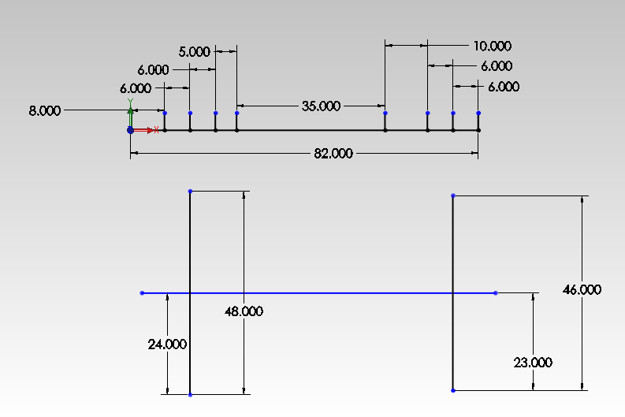
Suspension Layout
Compromise between chassis and suspension design
Averaged from well scoring FSAE teams

Slide 50
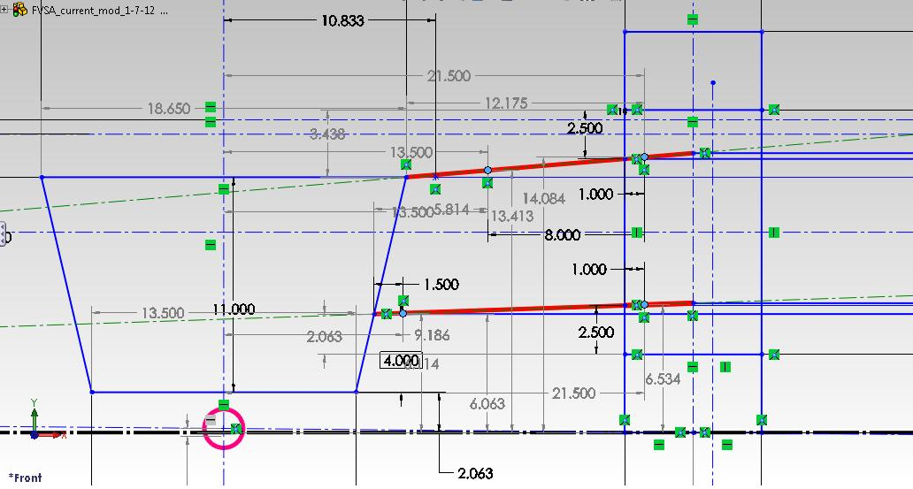
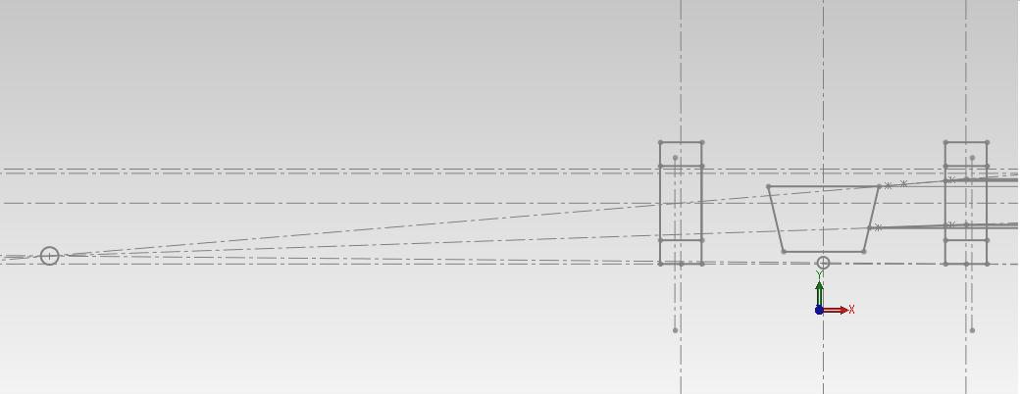
FVSA
Static case
Instant center location
Roll instant center location
FVSA length

Slide 51
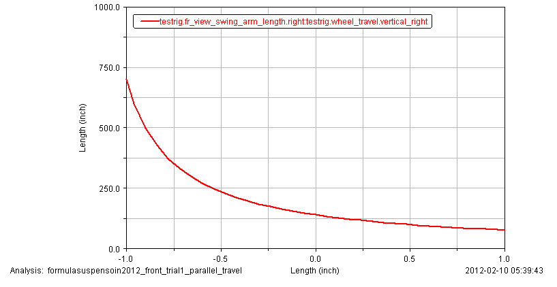
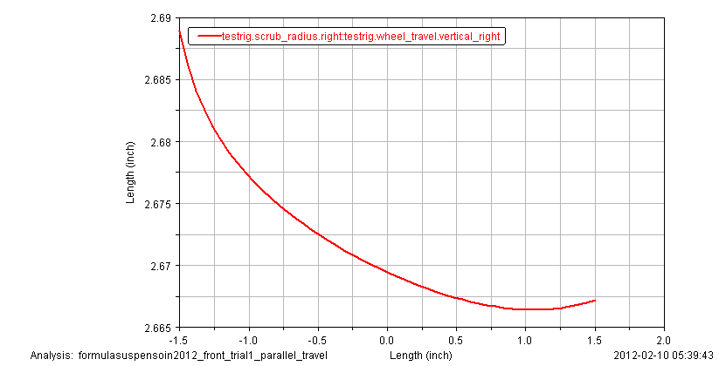
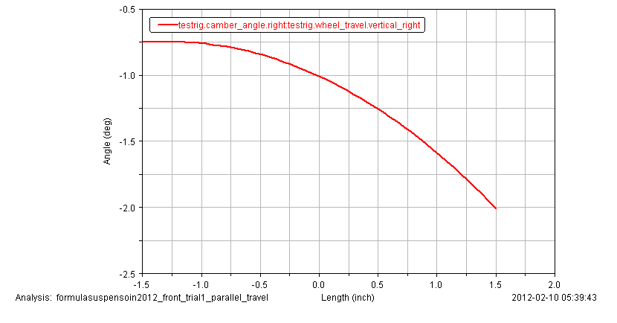
FVSA continued
FVSA Length
scrub
Minimize camber change
Reduce jacking effect
Reduce scrub
Camber

Slide 52
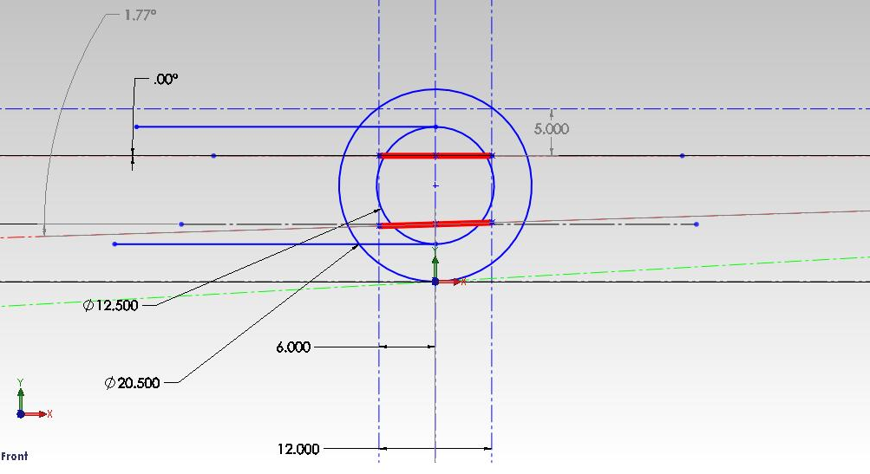
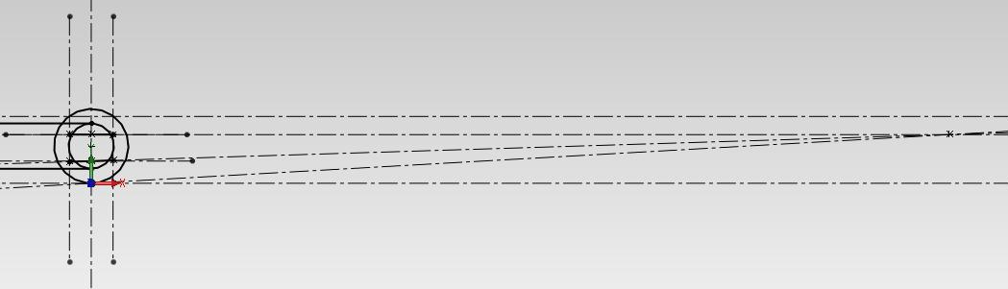
SVSA
Static case
Anti features
Instant center location
SVSA length

Slide 53
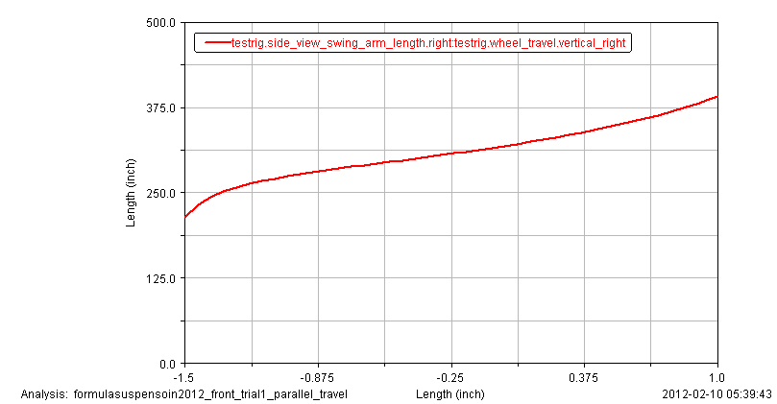
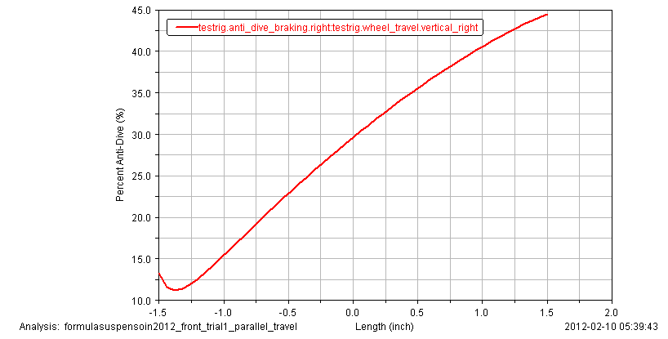
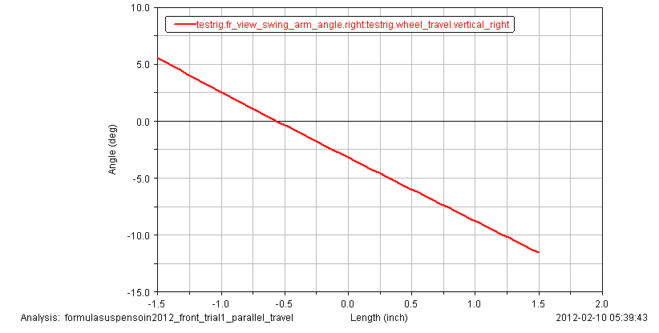
SVSA continued
% anti is relative to the amount of force carried in the members

Slide 54
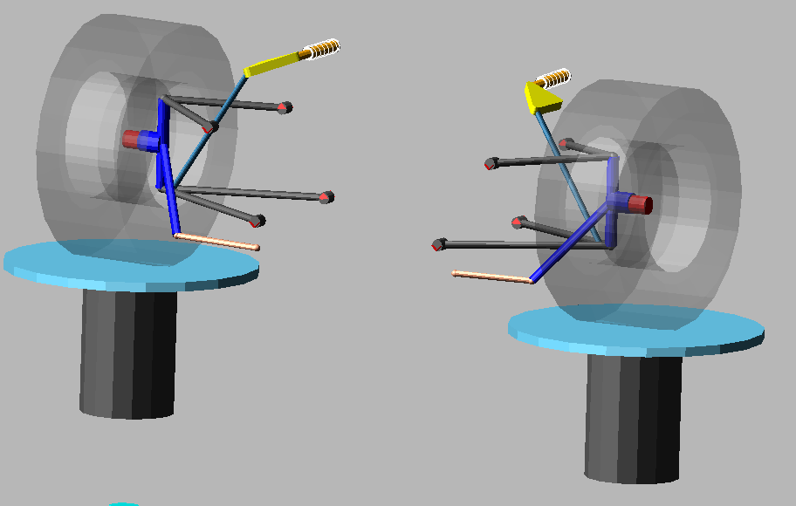
Adams-Car
Virtual product development software
Simulation of characteristics

Slide 55
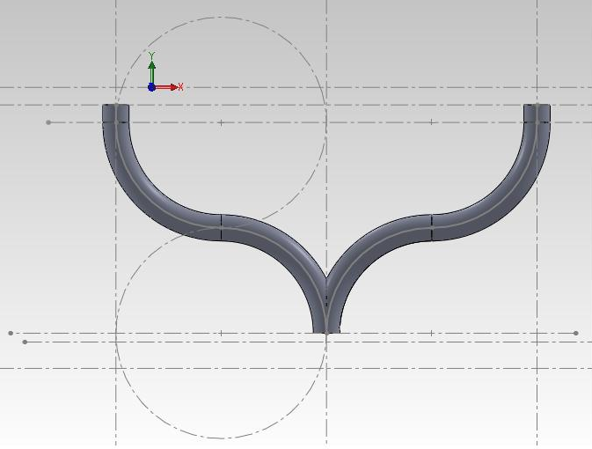
A-arm design
Steering clearance
Attachment to chassis
Adjustable

Slide 56
deadlines
February!
All suspension design and modeling will be completed at the end of this month

Slide 57
Test plan
Two stage plan
  Fitment
  Adjustment

Slide 58
Test 1
Objective:
  Fitment to rules and design
Procedure:
  Measure accurate mounting locations for suspension brackets.
    Ensure points are squared along longitudinal center
  Final placement

Slide 59
Test 2
Objective:
  Set up
    Determine optimal characteristics
Procedure:
  Test and tune suspension while other tests are being run
    Ensure toe, caster, camber, spring rate, and tire pressure are adjusted for optimal handling

Slide 60
Brakes and Components
Presented by:
SAM rISBERG

Slide 61
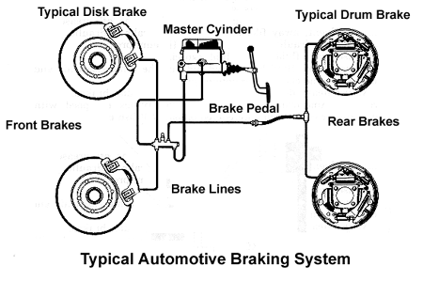
Designing Brake System
Typical braking system
-master cylinder, proportioning valve, brake lines, calipers, etc.

Slide 62
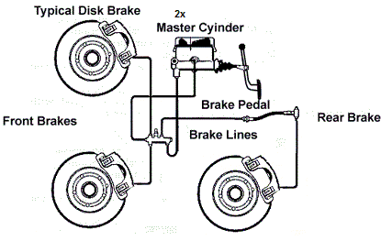
Our Formula Hybrid Braking System
We will only have one brake in the rear “inboard”, meaning connected to an un-sprung weight (rear differential)

Slide 63
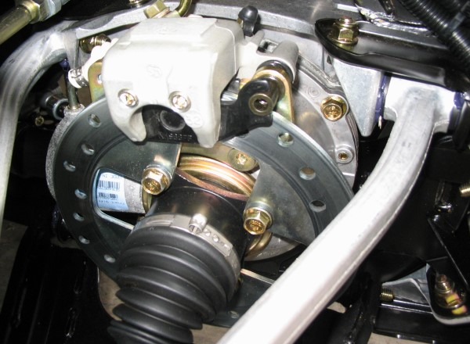
Inboard Braking
Inboard differential mounted brake rotor and caliper

Slide 64
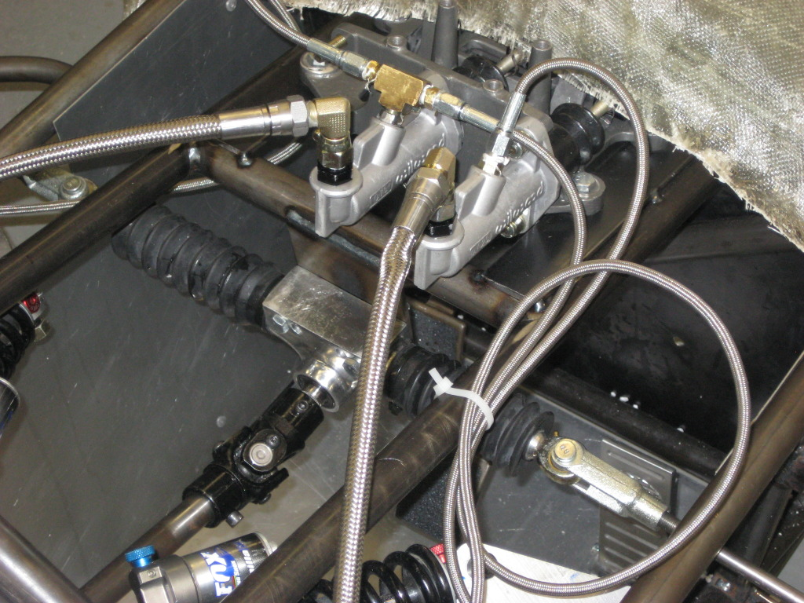
Our Formula Hybrid Braking System
Instead of one master cylinder and a proportioning valve we will have two master cylinders with a brake bias bar.

Slide 65
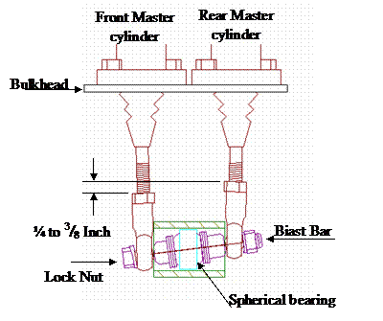
Brake bias bar
The bias bar will allow us to put more bias in the rear brakes or front respectively.
-This will be beneficial when using regenerative braking, which will most likely be implemented in next years car

Slide 66
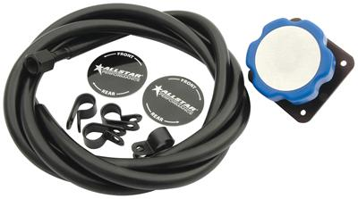
Remote Brake Adjustments
To change the brake bias on the fly would be impossible without tools.
With a remote bias adjuster we can change the rear/front brake bias on the fly!

Slide 67
Testing brake components
Required test for competition-
“The brake system will be dynamically tested and must demonstrate the capability of locking all four (4) wheels and stopping the vehicle in a straight line at the end of an acceleration run specified by the brake inspectors”

Slide 68
Steering
Presented by:
Tomas Bacci

Slide 69
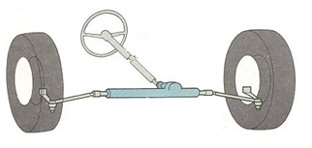

Steering Design Overview
Rack and Pinion steering
  Rotation on wheel displaces a rack horizontally
  Rack connects to uprights through the use of tie rods
  Rack is low mounted, tilted
www.motorera.com

Slide 70





Steering Design Overview
Reverse Ackermann
  Outside tire becomes more loaded in a turn
  Performance curves show peak cornering forces occur at higher slip angles as vertical tire load increases
  R.A rotates outside wheel sharper than the inside wheel
~1 deg of reverse Ackermann, almost parallel steer.

Slide 71


Adams Test Result
Steering characteristics verified using ADAMS CAR software
[how to achieve Reverse Ackermann]

Slide 72

Adams Simulation

Slide 73


Simulation Results

Slide 74

Rack Placement

Slide 75
Test Plan Ahead
Competition requirements
  Free Play in the Wheel
  Quick Disconnect
  Non-Binding
Additional
  Reverse Ackermann
  Test drive

Slide 76
Schedule and Ergonomics
Presented by:
Corey Souders

Slide 77

Project Scheduling
Construction of chassis underway
Start of Floor pan and Nose Cone
Bottle neck – chassis

Slide 78

Schedule

Slide 79
Ergonomics in Design of Vehicle
Determine the body dimensions that are important in the design
Define the user population
Determine principle (extreme, average, adjust)
Determine percentage of population to be accommodated
Factor in allowances

Slide 80

Leg Length
Used to determine the placement of the pedals
Measurements taken from hip to floor
Designed for average
2 inch allowance added
Range: 35” – 40”

Slide 81

Arm Length
Measured to determine placement of steering wheel
Designed for average
Measurements were taken from shoulder to palm of hand
Range: 28” – 30”

Slide 82

Seated Height and Body Width
Determined height of head rest and allow for enough room in cockpit
Seated Height – extreme
Body Width – average
Max Height: 36”
Max Width: 19”

Slide 83

Safety and Comfort
5 second exit rule
Seat
Arm rest
Minimum Leg Clearance
Roll Hoop Design

Slide 84
Budget and Purchases
Presented by:
Aldreya Acosta

Slide 85
Budget
Current Budget
- IE, ME &EE
-$1,513.17
-$683.76
- Total = $2,196.93

Slide 86
Inspection of Design
Presented by:
Corey Souders

Slide 87
Overview
Purchases required: 16
Incomplete Designs: 11
Systems in violation: 3

Slide 88
Items to Order
High Voltage (HV) Insulation (more)
HV box and stickers
HV and LV wiring (different colors)
HV Test Connector
Conduit anchors
Low Voltage Fusing
Electrical Relays (if we can’t find)
Fire Extinguisher
Rolling Bar Padding
Harness Replacement
Master Switches “Big Red Buttons” (more)
Lap Belt Mounting (or make)
Driver’s Suit (Gloves/Shoes/ Face Shield/Helmet)

Slide 89
Flexible Systems
Transponder Mounting
Rain Certification
Post-shutoff electrical decay
High Voltage Isolation
Drive train shields and finger guards
Arm and Head Restraints

Slide 90
Inflexible Systems
Low and High Voltage Fusing
Approval of Accumulator Monitoring system
Anti-Submarine Belt Mounting
Alternative Tubing and Material
Harness Requirements
Battery Management System (BMS) Fusing
Battery storage container
Electrical System Documentation
Main Hoop bracing
Impact Attenuator
Floor Closeout
Jacking Points

Slide 91
Action Required
Purchases must be made promptly
Finalize designs
Correct systems

Slide 92
Future Inspection Plans
Manufacturing Inspection
Post-Production Inspection
Monitor and complete tasks
Ensure the use of proper construction procedures
Reinforce initial inspection
Check that requirements are met
Finalize components
Submit competition documentation

Slide 93
Schedule for Near Future
Finish Chassis
Complete Suspension
Finalize material selection to make the mold for the body
Place additional orders

Slide 94
Summary
On schedule to complete vehicle
Designs complete on all major components
Visit us on the Web!
  http://eng.fsu.edu/me/senior_design/2012/team21/index.html
  Check out the website for updated pictures and documents.

Slide 95
Questions?
We appreciate any questions or critical feedback to improve our product.

Slide 96

Appendix - Steering

Slide 97

Appendix - Chassis

Slide 98

Appendix - Chassis

Slide 99

Appendix – Chassis

Slide 100

Appendix - Chassis

Slide 101

Appendix - Chassis

Slide 102

Appendix - Chassis

